Slide 1

DARTEP
Host: Central Michigan University
February 3, 2017

Slide 2

MDE System and Data Use
WHY?
Legislative Requirements
EPP data use
Responsibility to Citizens
  K-12 Students
  Candidates
Data Use
Licensure Tests
Surveys
Educator Effectiveness
Approvals
Accountability

Slide 3
EPP Continuous Improvement
EPP Data
MDE Data
EPP Systems

Slide 4
Michigan’s Teacher Preparation: Survey Data Overview

Slide 5
Purpose of Surveys
Identify, report and assist
Recognize excellent work
Share data to increase awareness
Share data to inform practice
Problem-solve
Facilitate feedback
Encourage collaboration
Notes:
Plan is to provide and overview and share data and perspective on a few areas that emerged through analysis.

Slide 6
Data Collection Method
2014-2015 and 2015-2016 surveys
    Teacher Candidates (TC)
    Candidate Supervisors (CS)
    Cooperating Teachers (CT)
    Year-Out Teachers(YO)
Notes:
You will note that two of the surveys contribute to your EPI score. You should receive your EPI reports by______________?

Slide 7
Survey Portfolio
When & What:
Two (2) Collection Periods, Annually-Fall/Winter & Spring/Summer
  Teacher Candidates
  Candidate Supervisors
  Cooperating Teachers
One (1) Collection Period, Annually-Spring/Summer
  Year-Out Teachers

Slide 8
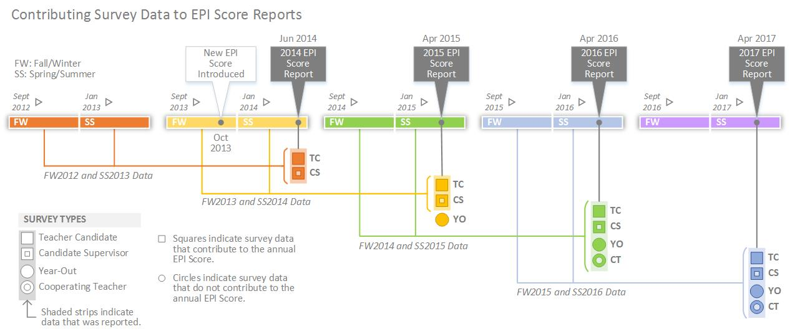

Slide 9
Survey Goals
Program Improvement
Engagement
Diagnostic for Technical Support
Data for Accreditation
Accountability–”Identify and Assist”

Slide 10
Statewide: Compiled Efficacy Scores Across Surveys
 | Cooperating Teacher |  | Candidate Supervisor |  | Teacher Candidate |  | Year Out
 | 2014-2015 | 2015-2016 | 2014-2015 | 2015-2016 | 2014-2015 | 2015-2016 | 2014-2015 | 2015-2016
DESIGNING HIGH-QUALITY LEARNING EXPERIENCES | 92% | 94% | 98% | 99% | 96% | 97% | 93% | 94%
CRITICAL THINKING | 89% | 92% | 98% | 98% | 95% | 96% | 92% | 92%
CONNECT CONTENT KNOWLEDGE TO REAL WORLD PROBLEMS AND LOCAL/GLOBAL ISSUES | 87% | 91% | 97% | 98% | 89% | 91% | 84% | 83%
USE TECHNOLOGY TO MAXIMIZE STUDENT LEARNING | 88% | 90% | 96% | 98% | 89% | 89% | 82% | 85%
ADDRESS THE LEARNING NEEDS OF SPECIAL POPULATIONS | 92% | 95% | 98% | 99% | 84% | 86% | 76% | 76%
SUPPORTIVE LEARNING ENVIRONMENTS | 89% | 92% | 98% | 99% | 94% | 95% | 90% | 91%
EFFECTIVE USE OF ASSESSMENTS AND DATA | 88% | 92% | 98% | 99% | 91% | 92% | 83% | 84%
SURVEY MEAN | 89% | 92% | 98% | 98% | 91% | 92% | 86% | 86%
N | 787 | 925 | 3561 | 3067 | 3572 | 3201 | 483 | 230
Notes:
Improvement in all domains and in over 90 percent of questions.

Slide 11
Statewide: Compiled Efficacy Scores Across Cohort
 | Cooperating Teacher | Candidate Supervisor | Teacher Candidate | Year Out
 | 2014-2015 | 2014-2015 | 2014-2015 | 2015-2016
DESIGNING HIGH-QUALITY LEARNING EXPERIENCES | 92% | 98% | 96% | 94%
CRITICAL THINKING | 89% | 98% | 95% | 92%
CONNECT CONTENT KNOWLEDGE TO REAL WORLD PROBLEMS AND LOCAL/GLOBAL ISSUES | 87% | 97% | 89% | 83%
USE TECHNOLOGY TO MAXIMIZE STUDENT LEARNING | 88% | 96% | 89% | 85%
ADDRESS THE LEARNING NEEDS OF SPECIAL POPULATIONS | 92% | 98% | 84% | 76%
SUPPORTIVE LEARNING ENVIRONMENTS | 89% | 98% | 94% | 91%
EFFECTIVE USE OF ASSESSMENTS AND DATA | 88% | 98% | 91% | 84%
SURVEY MEAN | 89% | 98% | 91% | 86%
N | 787 | 3561 | 3572 | 230

Slide 12
Overview
Across the four surveys and data collection period(s), three categories tend to have relatively low efficacy.
Connect Content to Real World Problems and Local and Global Issues.
Use Technology to Maximize Student Learning.
Addressing the Needs of Special Populations.

Slide 13
Statewide: Pattern of Compiled Efficacy Scores Across Surveys

Slide 14
Statewide: Rank Order of Compiled Efficacy Scores Across Surveys

Slide 15
Teacher Candidate Survey

Slide 16
Teacher Candidate: Two Low Score Categories and Corresponding Efficacies ‘14-’15, ’15-’16
USE TECHNOLOGY TO MAXIMIZE STUDENT LEARNING (5 items overall efficacy: 89%, 89%)
  Facilitate the creation of digital content by students. 87%, 87%
  Create an online learning environment for students which includes digital content, personal interaction and assessment. 82%, 83%
ADDRESS THE LEARNING NEEDS OF SPECIAL POPULATIONS (5 items overall efficacy: 84%, 86%)
  Adapt instructional strategies and resources to support English language learners. 77%, 81%
  Apply modifications and accommodations based on legal requirements for supporting English language learners. 77%, 80%
  Apply modifications and accommodations based on individualized education programs (IEPs). 86%, 87%

Slide 17
Year-Out Survey

Slide 18
Year-Out: Two Low Score Categories and Corresponding Efficacies ‘14-’15, ’15-’16
USE TECHNOLOGY TO MAXIMIZE STUDENT LEARNING (5 items overall efficacy: 82%, 85%)
  Facilitate the creation of digital content by students. 78%, 84%
  Create an online learning environment for students which includes digital content, personal interaction and assessment. 74%, 80%
ADDRESS THE LEARNING NEEDS OF SPECIAL POPULATIONS (5 items overall efficacy: 76%, 76%)
  Adapt instructional strategies and resources to support English language learners. 69%, 67%
  Apply modifications and accommodations based on legal requirements for supporting English language learners. 67%, 70%
  Apply modifications and accommodations based on individualized education programs (IEPs). 79%, 78%

Slide 19
Candidate Supervisor Survey

Slide 20
Candidate Supervisor: Two Low Score Categories and Corresponding Efficacies ‘14-’15, ’15-’16
USE TECHNOLOGY TO MAXIMIZE STUDENT LEARNING (5 items overall efficacy: 96%, 98%)
  Facilitate the creation of digital content by students. 94%, 96%
  Create an online learning environment for students which includes digital content, personal interaction and assessment. 92%, 96%
  ADDRESS THE LEARNING NEEDS OF SPECIAL POPULATIONS (5 items overall efficacy: 98%, 99%)
  Adapt instructional strategies and resources to support English language learners. 98%,99%
  Apply modifications and accommodations based on legal requirements for supporting English language learners. 98%, 99%
  Apply modifications and accommodations based on individualized education programs (IEPs). 99%, 99%

Slide 21
Cooperating Teacher Survey

Slide 22
Cooperating Teacher: Two Low Score Categories and Corresponding Efficacies ‘14-’15, ’15-’16
Connect Content Knowledge to Real-World Problems and Local and Global Issues (4 items overall efficacy: 87%, 91%)
  Connected content knowledge to LOCAL issues in his or her teaching. 86%, 89%
  Connected content knowledge to GLOBAL issues in his or her teaching. 87%,90%
  Developed meaningful learning experiences to help students apply content knowledge to real world problems. 89%,93%
Using Technology to Maximize Student Learning (5 items overall efficacy: 88%,90%)
  Facilitated the creation of digital content by students. 82%, 85%
  Created an online learning environment for students which included digital content, personal interaction, and assessment. 75%, 79%
  Integrated digital content into her or his teaching which is pedagogically effective. 88%, 92%

Slide 23
“Did Not Observe”
Raters:
Candidate Supervisor
Cooperating Teacher

Slide 24
Candidate Supervisor
Categories Most Affected by “Did Not Observe” Responses
Use Technology to Maximize Student Learning.
Address Learning Needs of Special Populations.

Slide 25

Accounting for “Did Not Observe” Responses”- Candidate Supervisor
*
Did not observe (DNO) responses are included in denominator for purpose of recalculation.
DNOs are not added to any disagree response.

Slide 26
Accounting for “Did Not Observe” Responses- Candidate Supervisor
*
*
Did not observe (DNO) responses are included in denominator for purpose of recalculation.
DNOs are not added to any disagree response.

Slide 27
Cooperating Teachers
Categories Most Affected by “Did Not Observe” Responses
Connect Content Knowledge to Real World Problems- Local and Global Issues.
Use Technology to Maximize Student Learning.

Slide 28
Accounting for “Did Not Observe” Responses- Cooperating Teacher
*
*
Did not observe (DNO) responses are included in denominator for purpose of recalculation.
DNOs are not added to any disagree response.

Slide 29
Accounting for “Did Not Observe” Responses- Cooperating Teacher
*
*
Did not observe (DNO) responses are included in denominator for purpose of recalculation.
DNOs are not added to any disagree response.

Slide 30
While we focused mostly on opportunities for growth; we thank you for the excellent work and the improvements reflected in the surveys!

Slide 31
Statewide: Compiled Efficacy Scores Across Surveys ‘14-’15, ‘15-’16
 | Cooperating Teacher |  | Candidate Supervisor |  | Teacher Candidate |  | Year Out
 | 2014-2015 | 2015-2016 | 2014-2015 | 2015-2016 | 2014-2015 | 2015-2016 | 2014-2015 | 2015-2016
DESIGNING HIGH-QUALITY LEARNING EXPERIENCES | 92% | 94% | 98% | 99% | 96% | 97% | 93% | 94%
CRITICAL THINKING | 89% | 92% | 98% | 98% | 95% | 96% | 92% | 92%
CONNECT CONTENT KNOWLEDGE TO REAL WORLD PROBLEMS AND LOCAL/GLOBAL ISSUES | 87% | 91% | 97% | 98% | 89% | 91% | 84% | 83%
USE TECHNOLOGY TO MAXIMIZE STUDENT LEARNING | 88% | 90% | 96% | 98% | 89% | 89% | 82% | 85%
ADDRESS THE LEARNING NEEDS OF SPECIAL POPULATIONS | 92% | 95% | 98% | 99% | 84% | 86% | 76% | 76%
SUPPORTIVE LEARNING ENVIRONMENTS | 89% | 92% | 98% | 99% | 94% | 95% | 90% | 91%
EFFECTIVE USE OF ASSESSMENTS AND DATA | 88% | 92% | 98% | 99% | 91% | 92% | 83% | 84%
SURVEY MEAN | 89% | 92% | 98% | 98% | 91% | 92% | 86% | 86%
N | 787 | 925 | 3561 | 3067 | 3572 | 3201 | 483 | 230
Notes:
Improvement in all domains and in over 90 percent of questions.

Slide 32
Survey Management
Accurate EPI contact information – Imperative
Accurate participant rostering- Through Validation Process
Informed and engaged survey participants
Increase response rate

Slide 33
Topics for Small Group Discussions
Addressing needs of English Learners
Addressing needs of special education students
Addressing technology for instruction
Challenge of “Did not observe”
See Google Doc and/or group handout for guiding questions.

Slide 34
Break Out Reminders
English Learners
Special Education
Technology for Instruction
Did Not Observe
Year Out Surveys

Slide 35
THANK YOU!

