Slide 1
December DARTEP Updates
Office of professional preparation services

Slide 2
NEW
THE OFFICE OF
EDUCATOR WORKFORCE
Notes:
Work Added
Educator Evaluation
Teacher of the Year
Michigan Teacher Leadership Advisory Council
Research and Data Unit
#proudMIeducator Campaign
Not sure yet how the structure will change
3. Staff Introductions

Slide 3
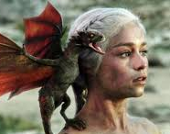
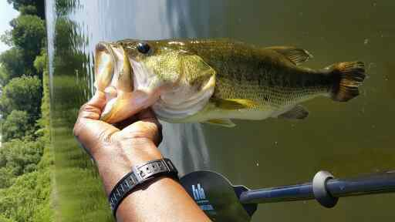
Introductions of Staff
Leah Breen
Phil Chase
Sarah-Kate LaVan
Krista Ried
Dana Utterback
Preston Hicks
Gina Garner
Sean Kottke

Slide 4
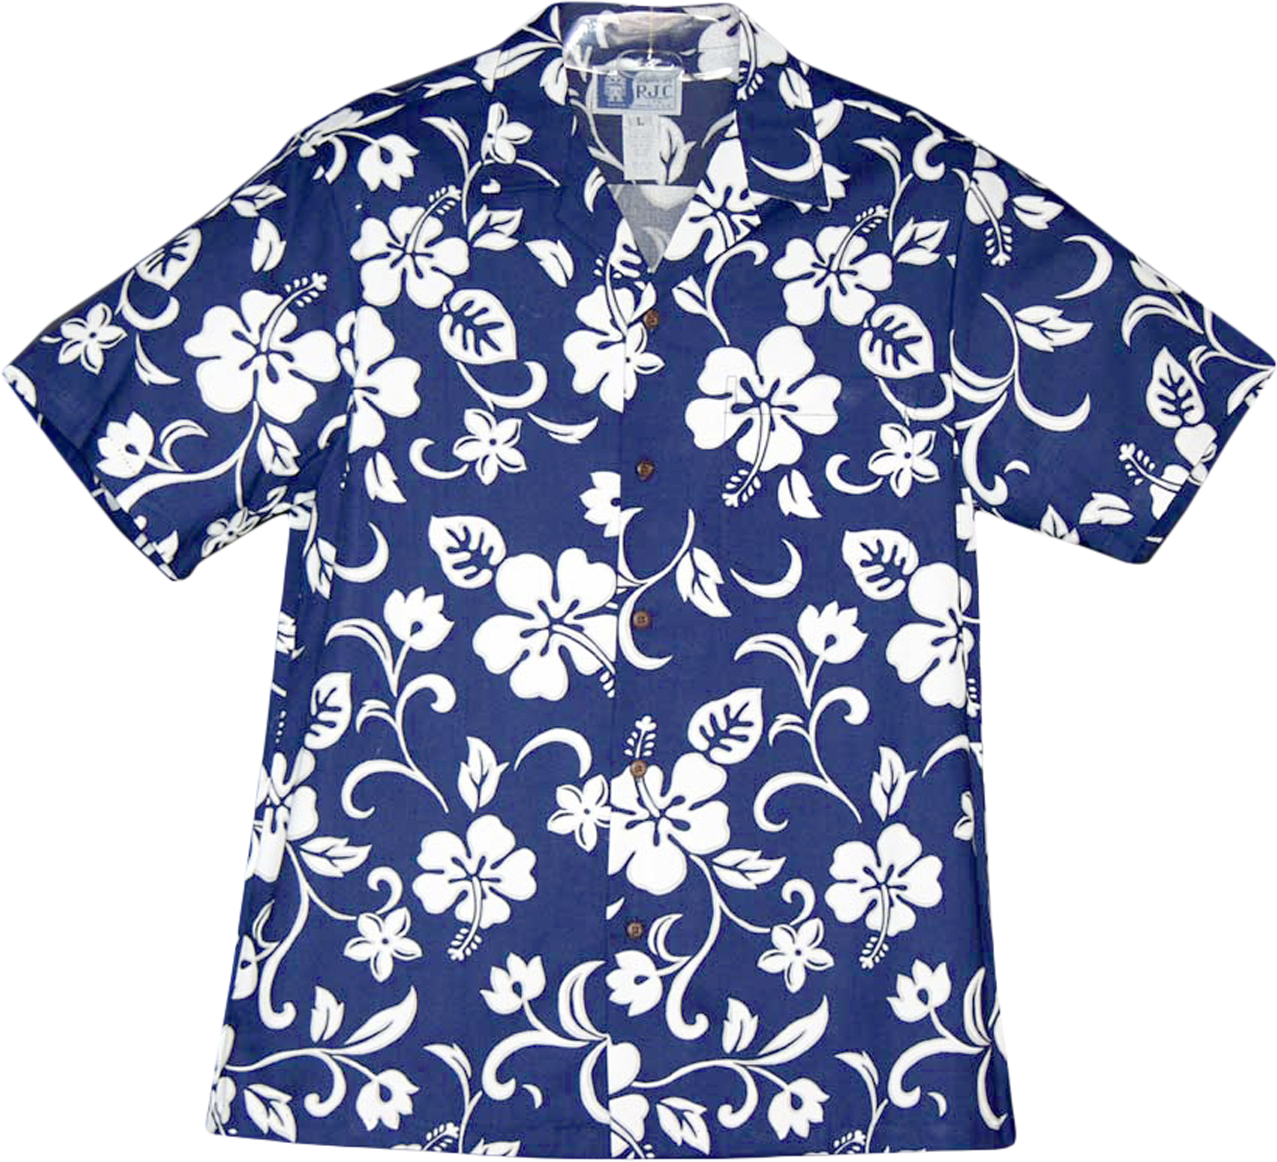
And of course…
Steve Stegink’s final DARTEP!
We will miss you Steve.

Slide 5
Legislative Update
Leah

Slide 6
Growing-Your-Own
HB 4181 – amended MCL 380.1233 – signed
HB 5141 – if ever there were a time to rally, now is a good time.
Notes:
4181 – school counselors need to spend 25 of their required 150 hours every five years engaged in professional learning specific to career counseling; those programs need to be approved by MDE; opportunity for you. Also, the new law requires we have college admissions professionals on our stakeholder groups to determine program standards; volunteers should contact Beatrice Harrison;
HB 5141 – you need to read this carefully; we believe it says that an individual with a HS diploma may receive an interim cert based on experience, then move directly to a provisional cert; this eliminates the requirement for ANY prep program including an alternate route program

Slide 7
Myth Busters and Flexibilities

Slide 8
Flexible Staffing Solutions
Krista

Slide 9
Growing-Your-Own
Current Certified Staff
Student Teachers
Paraprofessionals
Out-of-State Candidates
Career Changers
Community Members

Slide 10
Substitute Teacher Permits & Approvals
Full-year
Basic Permit
Full-year Shortage Permit
Expert Permit
Daily Substitute Permit
Special Education Approval
Annual CTE Auth.
http://www.michigan.gov/documents/mde/Permit_Overview_529841_7.pdf

Slide 11
Educator Preparation Programs
Alternative Routes to Teacher Certification
Residency Programs
Accelerated Programs
Traditional Programs
Notes:
Do we need to add Post-baccalaureate Programs? I know that this is what SVSU calls their program.

Slide 12
Current Certified Staff
First 90-Calendar Days
Special Education Approvals
Full-year Shortage Permits
Full-year Basic Permits
EPP Partnership:
Alternative Route Programs: Additional Endorsements
Interim Teaching Certificate

Slide 13
Student Teachers
Full-year Basic Permits
EPP Partnerships
Accelerated Programs
Residency Programs
Traditional Programs

Slide 14
Paraprofessionals
Full-year Basic Permits
Annual CTE (Occupational) Authorizations
EPP Partnerships
Accelerated Programs
Residency Programs
Traditional Programs
Alternative Route Programs
Interim Teaching Certificate

Slide 15
Out-of-State Candidates
What is “Reciprocity”
Professional as initial (no testing required)
Temporary Teacher Employment Authorization
96-98% acceptance rate
Special Education Approvals
Daily Substitute Permits

Slide 16
Career Changers
Full-year Basic Permits
Annual CTE (Occupational) Authorizations
EPP Partnerships
Accelerated Programs
Residency Programs
Traditional Programs
Alternative Route Programs
Interim Teaching Certificate

Slide 17
Community Members
Expert Permits
Annual CTE (Occupational) Authorizations

Slide 18
Does every EPI need every program?
How do I offer that program those three candidates want?
Gina

Slide 19
Program Choice
How many options should you offer?
Candidate choice
Program tracking
Low enrollment programs (low n MTTC)
What choices do you have?
Interinstitutional agreements
Consortiums

Slide 20
Interinstitutional Agreements
Connect with EPPs to offer additional programs
Agreement outlines which institution will provide each part of the program
Coursework
Field Experiences
Student Teaching
Final Recommendation
MTTC data belongs to host EPP
Clear language in agreement

Slide 21
Consortiums
Used to create a pathway for low incidence endorsements
Connects multiple institutions and/or states
Consortiums in MI
Visual Impairment (SK)
Deaf and Hard of Hearing (SL)
MDE recommends candidates

Slide 22
Special Education Update
Gina

Slide 23
Special Education Program Review
Data request will be sent from MDE to EPPs in early January 2018
Special Education Programs Verify:
Program credit and course requirements
Program claims and assessments
Alignment to MARSE and InTASC standards
Data for continuous improvement

Slide 24
Special Education Program Review
Special Education Programs Send to MDE:
Verification if information has not changed
Amendment form for minor changes/tweaks
Program application form for new programs or programs that have been significantly changed from previous approval.

Slide 25
Education Evaluation Labels
Preston

Slide 26
Educator Evaluation Labels
Calendar
Educator Effectiveness Roster Verification Window
January 18 - February 8
Final Educator Effectiveness Rating Reports to EPIs
March 2, 2018

Slide 27
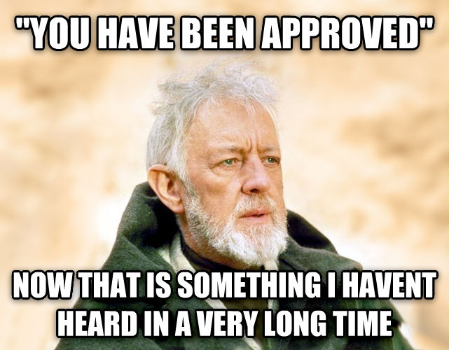
Program Approval
Gina

Slide 28
Program Approval Is Opening!
2 Program approval windows each year
Fall: November
Spring: April
2017-2018 Academic Year only:
Fall: December –January 2018
Spring: April 2018

Slide 29
Program Approval Q & A
Q: I’m ready to submit a program application or revision. What do I do?
A: Contact the MDE consultant for the program you are submitting for an application and more information
Q: How do I determine which consultant to contact?
A: See our list at http://www.michigan.gov/documents/mde/Educator_Program_Consultants_605956_7.pdf

Slide 30
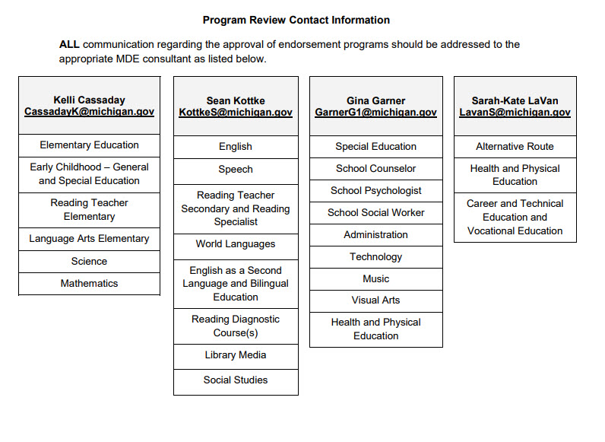

Slide 31
Appropriate Placement: Library Media and School Counselors
Phil

Slide 32
Reports of inappropriate assignments
Meetings with stakeholders to create guidance documents (July-Aug 2017)
Communications with field
(Nov 2017-May 2018)
Routine State Aid Deductions begin
(Academic Year 2018-2019)

Slide 33
New Administrative Rules: What do you need to know now?
Sean and Krista

Slide 34
R 1123 – “Program”
Consolidates into one rule initial *Standard* Teaching Certificate requirements previously spread across multiple rules
a. Professional sequence (min. 20 SH)
b. Supervised directed teaching (min. 12 wks)
c. Approved course of study in a certificate endorsement program (incl. discipline area knowledge, pedagogy & field experiences)
ii. Elementary: base knowledge for elementary ed + 1 discipline area appropriate to elementary, 6 SH in literacy
iii. Secondary: 1 discipline area appropriate to secondary, 3 SH in literacy
Program Standards define minimum credit requirements
NOTE: Initial Standard Certs & all renewals are valid for 5 years
Option 1 vs. Option 2 for Elementary Candidates
Teachable Minor for Secondary Candidates

Slide 35
R 1123 – Implications
Removal of secondary minor requirement
Institutional decision, no additional approvals
Experimental programs waiving minor will be converted to traditional (we’ll contact you)
Note that ESL, Bilingual & Special Education still require pairing with core academic content area
Removal of Option 1 and 2
No state-mandated changes until new cert structure & standards debut
If EPP wishes to make changes now, please use Report of Program Change

Slide 36
R 1129 – “Additional Endorsement”
1. Minimum of 20 SH (but always consult program standards)
*NEW* 2. Must include pedagogy & field experiences (Fall 2019 = deadline for adding these)
3. MTTC
4. Already certified candidates may combine new & previous coursework to meet 20 SH
Additional Endorsement [1129]
Initial Endorsement Area [1123 (c)]
Professional Sequence & Student Teaching [1123(a-b)]

Slide 37
Certification Structure Revision Update
Steve

Slide 38
DRAFT

Slide 39
MTTC Updates
Steve’s Last Dartep presentation

Slide 40
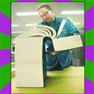
MTTC Test Development
Objective framework; Items; Standard setting
Health Education and Physical Education
Cognitive Impairment, Emotional Impairment, Learning Disabilities, Autism Spectrum Disorder
Bilingual Education
English as a Second Language
Notes:
Slide has Fly-in Animations of internal lines
HE/PE full development from new standards for single endorsement: two non-compensatory subtest/tests
Other fields with objective realignment review, item refresh, consideration of new cutscore

Slide 41
MTTC NOMINEES INVITATION
Michigan K-12 teachers and College/University teacher educators
Instructional Leaders
Research Leaders
Exemplar Practitioners
www.mirecruit.nesinc.com
Notes:
Slide has Fly-in Animations of internal lines

Slide 42
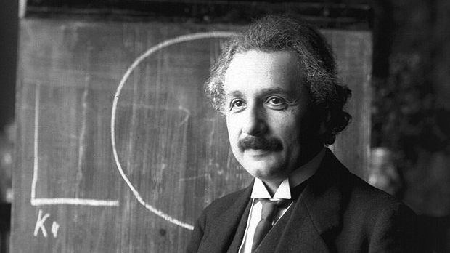
MTTC RESULTSANALYZER
MDE/EPI Users’ Group
EPI Performance Report
Program and Candidate Support
CAEP
Enhancements
Late-January 2018 – Early-February 2018

Slide 43
SAT Transition
Complete registration necessary
Verification e-mail and response – MI Teacher Certification
Full attendance
Adult cohort – EPI site
Notes:
Slide has Fly-in Animations of internal lines
And final image, “Together we will produce a bright, shiny gem”

Slide 44
Hope Accreditation Conference
Working together towards continuous improvement
Gina and Doug

Slide 45
Hope Conference-April
April 4-5
A Practical Approach to Continuous Improvement
Information Sessions and Open Sessions
Sharing from EPPs-Volunteer via survey
Continuous Improvement processes-innovation and success
Site Visit experiences
You set the agenda! Take the survey. (See update for link)

Slide 46
Job-Alike Sessions
Directors and Deans-
Accreditation Coordinators-
Student Teaching Directors-
Certification Officers-

