Slide 2
Michigan’s Teacher Shortage: 2023 Comprehensive Report
Presented to DARTEP
February 3, 2023
Tara Kilbride, Ph.D.
Assistant Director for Research, EPIC
College of Education | Michigan State University

Slide 3
Agenda
Background, Data, and Methods
01
02
Teacher Vacancies
03
Retention, Mobility, and Attrition
04
Teacher Preparation
05
Highest-Need Regions
06
Implications

Slide 4
Background: Public Act 316 of 2020
“… by January 1, 2023 and January 1 each year thereafter, CEPI, with partners under this subsection, shall submit a comprehensive report concerning educator shortages …
… The comprehensive report must include, but is not limited to, the following:”
The number of educator vacancies in this state, disaggregated by geographic region and by any broad subject areas and educational settings required for those vacancies.
The educator retention rates in this state, disaggregated by geographic region, broad subject areas and educational settings, number of years in the profession, and educator demographics.
The number of graduates from approved, in-state teacher preparation programs, disaggregated by the broad subject areas and educational settings of those graduates.
An analysis of the regions in this state that present the highest need for educators based on educator shortages in those regions, disaggregated by the broad subject areas and educational settings of the positions in which there are shortages in those regions.

Slide 5
According to NCTQ, these data elements are essential for policymakers and education leaders to have the actionable information they need to address teacher shortages. All of this information is available, to some extent, in Michigan’s state datasets. However, some of it comes with caveats, such as:
Data & Methods
Supply of Teachers
Number of active teachers
Number of newly certified teachers
Number of teachers who are certified but not employed as teachers
Demand for Teachers
Number of teacher vacancies
Classes taught by teachers who are not fully licensed or out-of-field
Capacity of the Teacher Supply to Meet the Demand
Positions covered by new hires
Positions covered by newly certified teachers
Positions filled by teachers who are not-fully-certified, out-of-field teachers, or long-term substitute teachers
Positions that remained unfilled
Teacher attrition
Teacher mobility
Reasons for leaving
Incomplete reporting and/or incomplete coverage
Multiple interpretations depending on districts’ staffing strategies

Slide 6
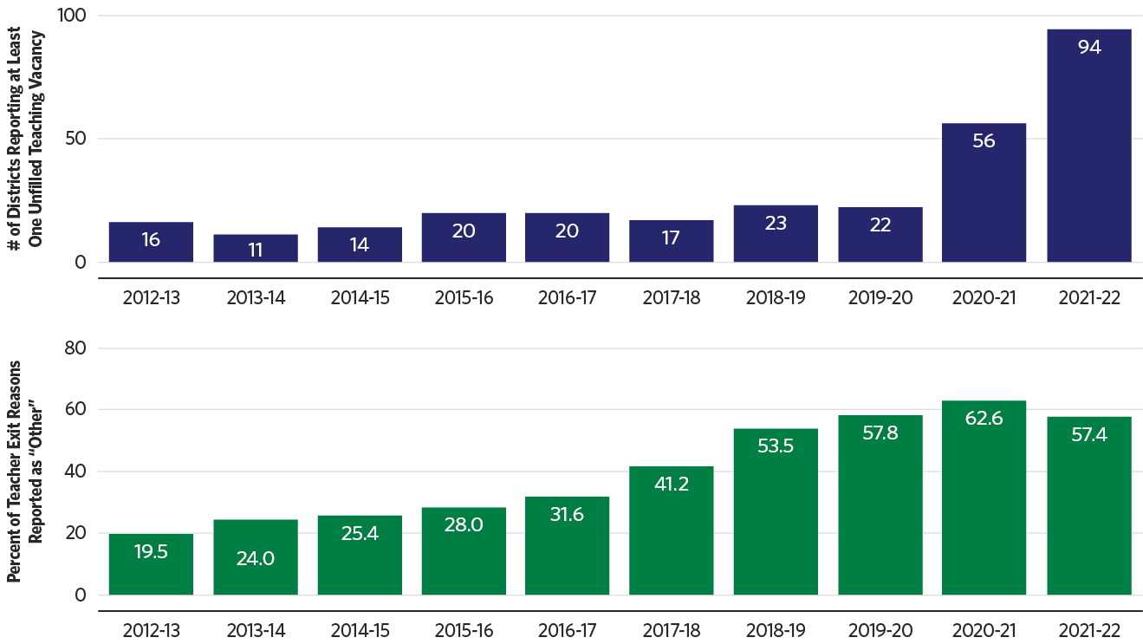
Data & Methods
Available state data provide a limited picture of Michigan’s teacher shortage. The data are gradually improving, but this is a long-term effort.
Districts are not required by law to report unfilled vacancies. While the number of districts reporting vacancies has increased, most districts (including many with known vacancies) still do not report any.
When a teacher terminates their employment, their district most select a category describing the reason for their exit. The majority of teacher exit reasons are reported as “other.”

Slide 7
Data & Methods
We consider several imperfect and indirect indicators to better understand the nature and extent of teacher shortages in Michigan and how they vary for different types of teachers, districts, and geographic locations.
Vacancies
District-reported teaching positions; reliance on teachers with temporary credentials; reliance on teachers who are shared across multiple sites; reliance on teachers contracted through 3rd-party virtual providers.
Retention
Entry into the profession; exits from the profession; within- and between-district transfers; maintenance of teaching credentials.
Teacher preparation
Newly-certified teachers; proximity of teacher preparation provider to location of first teaching job.
Highest-need regions
Estimated extent of local shortages based on patterns across all relevant indicators; overall and subject-specific shortages.

Slide 8
Results:
Teacher Vacancies

Slide 9
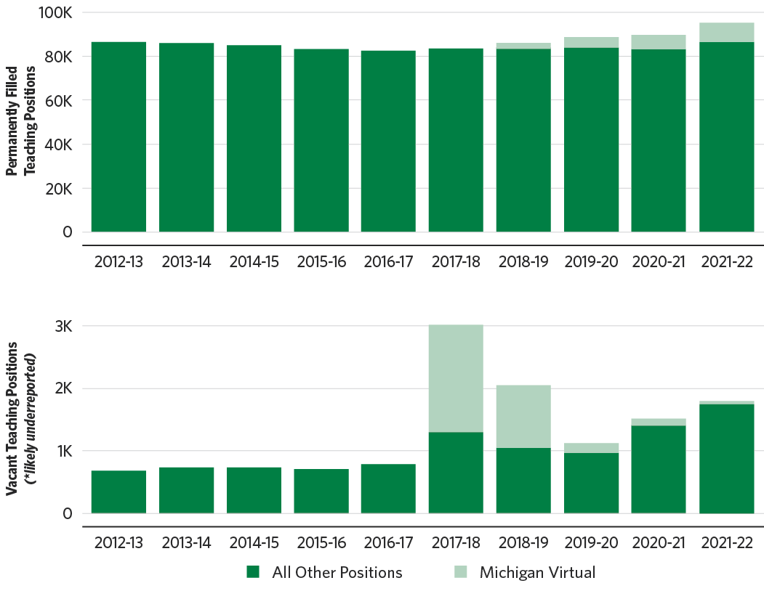
Teacher Vacancies
Districts reported more teaching vacancies and more filled teaching positions in 2021-22 than in previous years.
District-reported filled and vacant teaching positions
Recent expansions to virtual learning options in Michigan are driving some of these trends.
Michigan Virtual teachers account for most of the increase in filled teaching positions over time.
About half of all teaching vacancies reported in 2017-18 and 2018-19 were Michigan Virtual teaching positions.

Slide 10
Teacher Vacancies
Districts are relying more on multi-site teachers and 3rd-party virtual course providers to meet their staffing needs.
Percent change from 2018-19 to 2021-22
Multi-site and 3rd-party virtual teachers are most prevalent in rural districts.
Multi-school teachers tend to be experienced, veteran teachers whereas multi-district teachers tend to be early in their careers.
Art, music, and world language teachers frequently travel between multiple schools.
Teachers assigned to more than one school | +10%
Average number of schools per multi-school teacher | +21%
Teachers assigned to more than one district | +67%
Average number of districts per multi-district teacher | +49%
Teachers contracted through Michigan Virtual | +153%
Average number of districts per Michigan Virtual teacher | +5%
3rd-party virtual course teachers | +60%
Average number of districts per 3rd-party virtual teacher | +53%

Slide 11
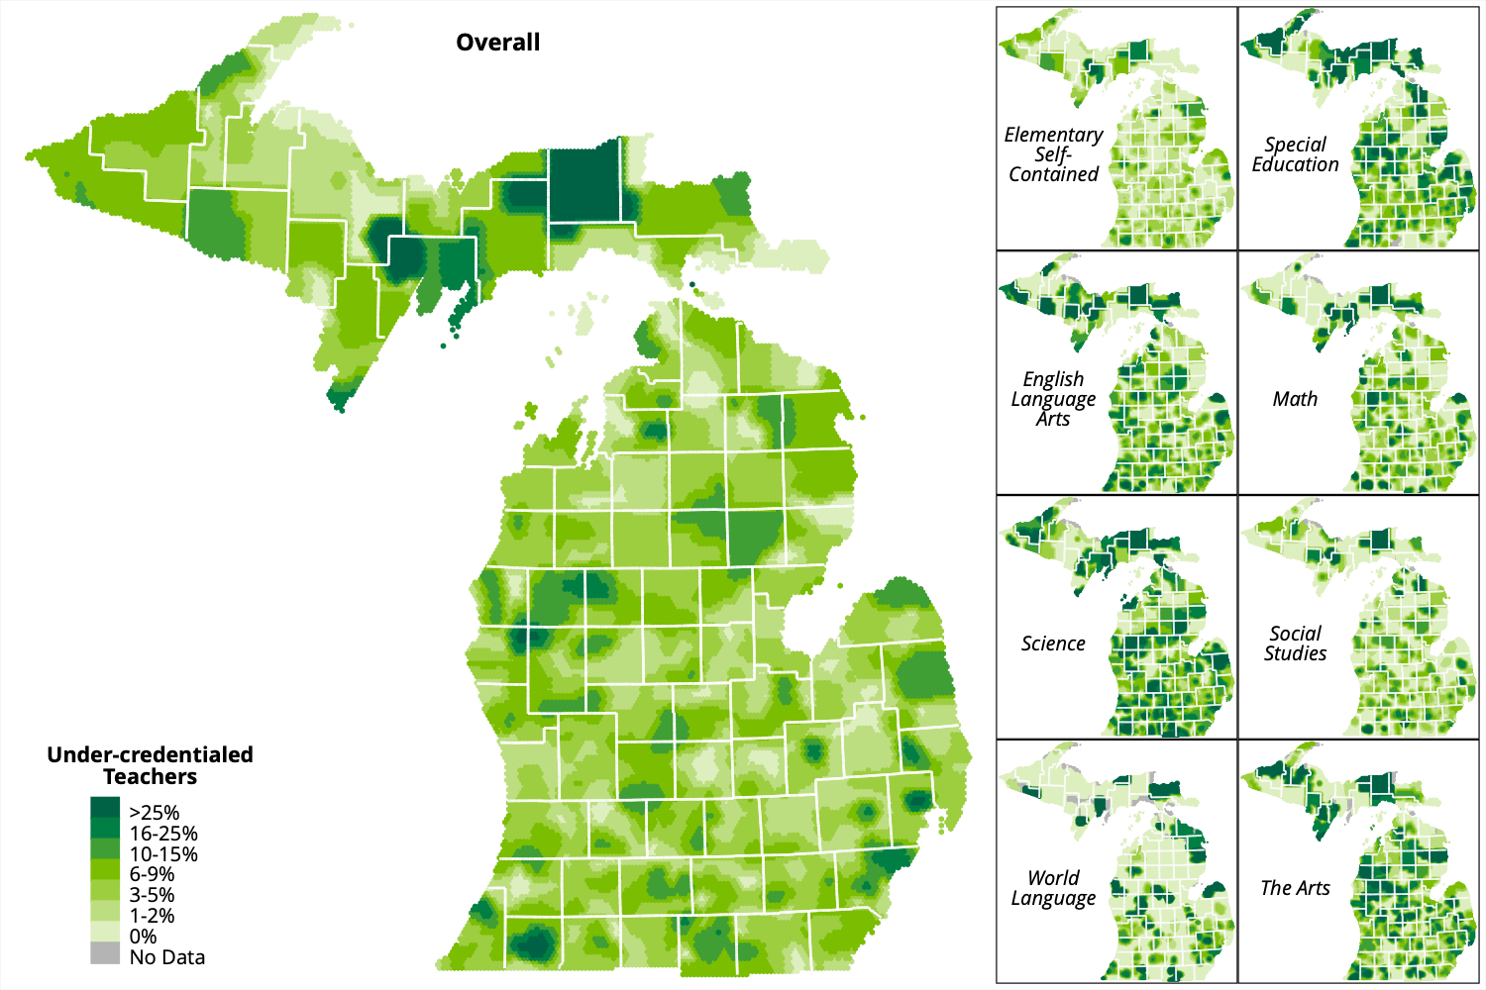
Teacher Vacancies
Districts are relying more on under-credentialed teachers to meet their staffing needs.
Increases in temporary credentials issued from 2018-19 to 2021-22:
Full-year substitute teaching permits: +141%
Extended daily substitute teaching permits: +51%
Science teachers, and in some areas of the state, ELA and special education teachers are the most likely to be under-credentialed.
Percent of teachers who are not certified and/or not appropriately endorsed for their teaching assignment
Notes:
.

Slide 12
Results: Retention, Mobility, and Attrition

Slide 13
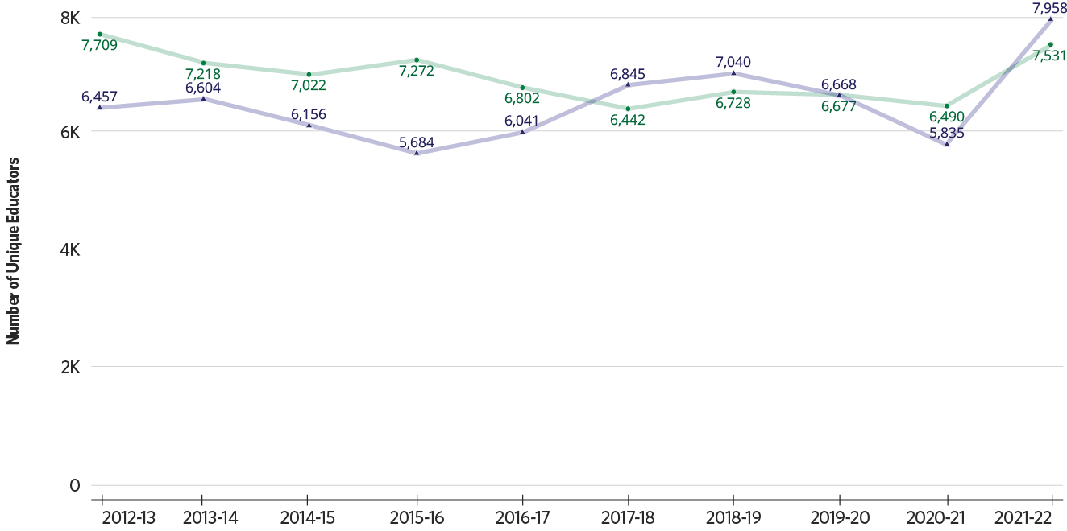
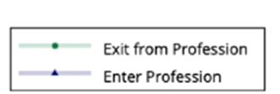
Retention, Mobility, and Attrition
More teachers are entering and exiting Michigan schools in the wake of the COVID-19 pandemic.
Entry into and exits From the teaching profession (fall-to-fall)

Slide 14
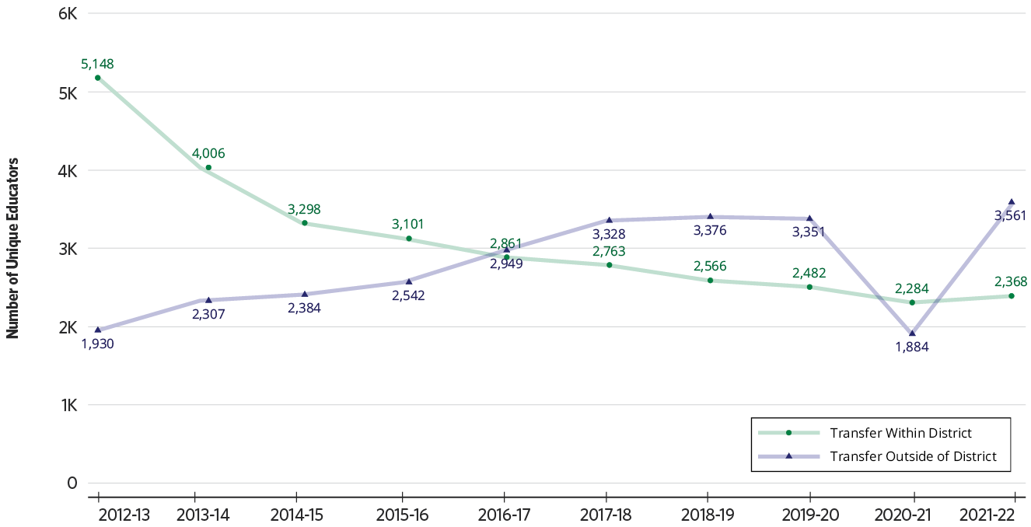
Retention, Mobility, and Attrition
Mobility between districts dropped to a new low in 2020-21 then jumped to an all-time high in 2021-22.
Teachers transferring to other schools or districts (fall-to-fall)

Slide 15
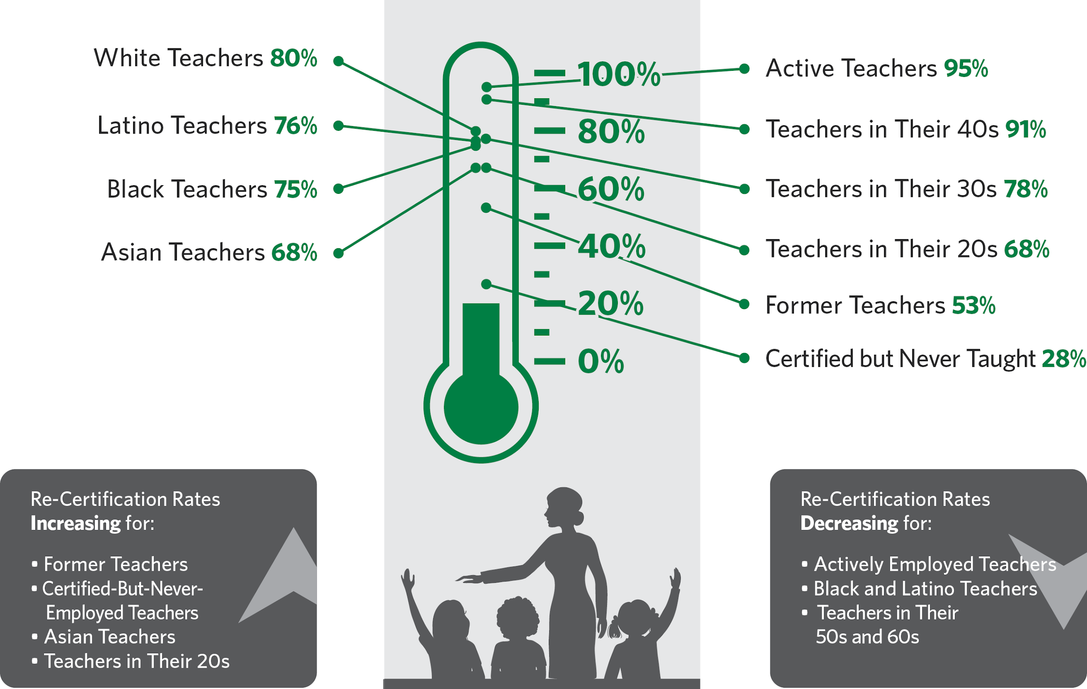
Retention, Mobility, and Attrition
“Re-certification” rates show the percentage of teachers who renewed or progressed to more advanced certificates within a year of their expiration.
Notes:
Notes: the re-certification rates for active/former/certified-but-never-taught are based on the initial certificate term only and do not include individuals who have previously renewed or progressed their certificates. The re-certification rates by race/ethnicity and age are based on all individuals with expiring certificates, regardless of whether they have previously renewed or progressed their certificates.

Slide 16
Results: Teacher Preparation

Slide 17
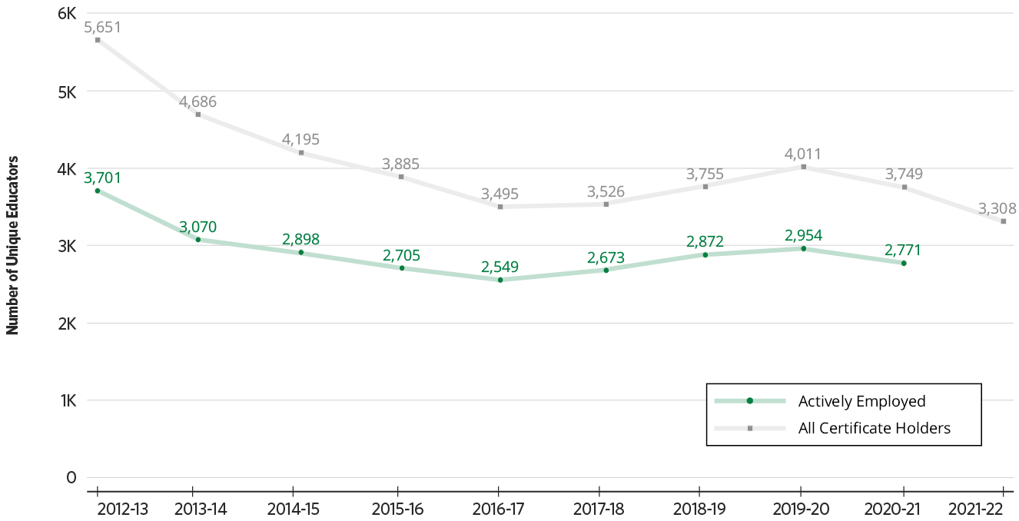
Teacher Preparation
In each year since the onset of the COVID-19 pandemic, Michigan has issued fewer initial teaching certificates in all grade ranges, subject areas, and educational settings.
Teachers issued initial certificates

Slide 18
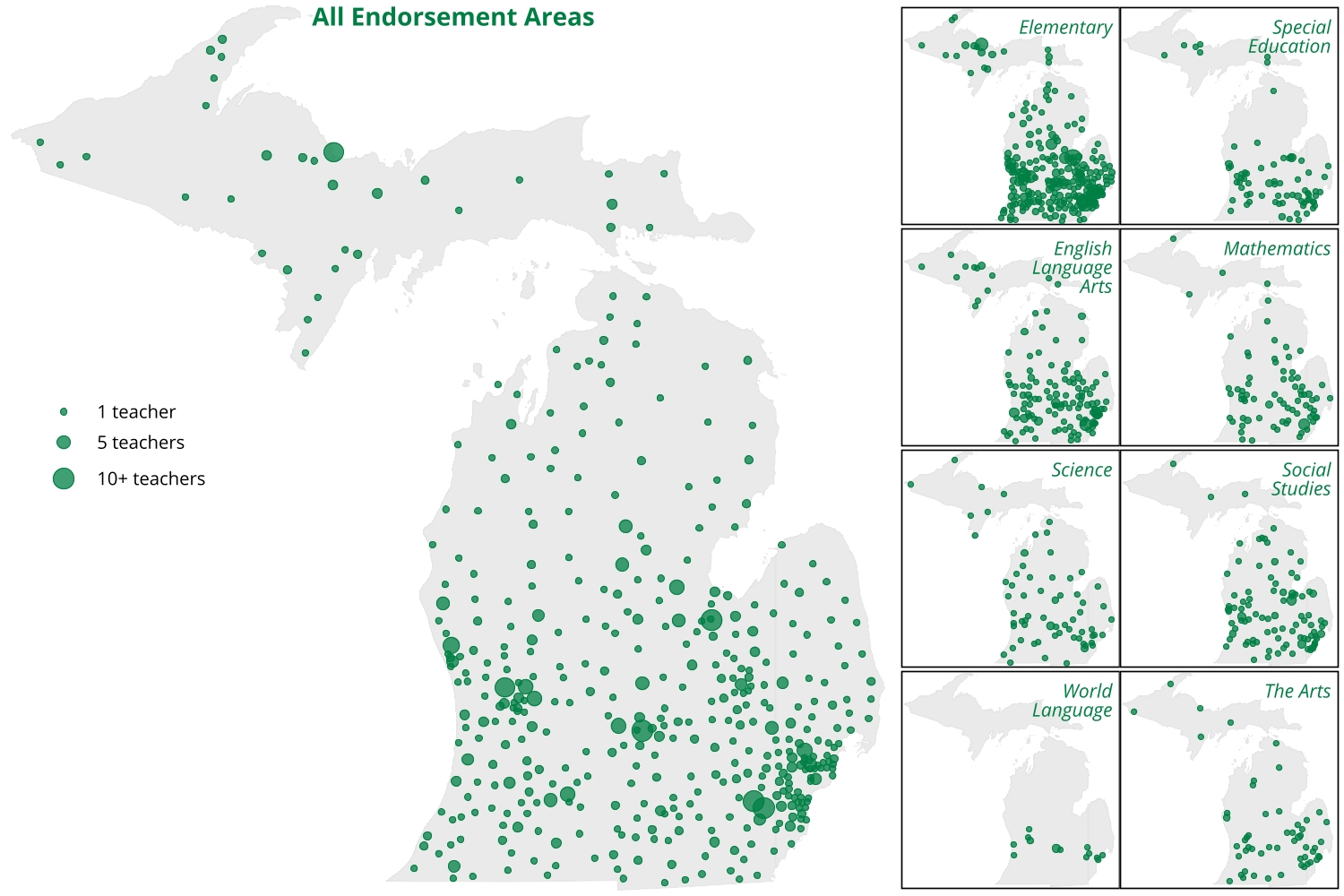
Teacher Preparation
Recent graduates from Michigan teacher preparation programs worked as first-year teachers throughout the state in 2021-22, but new graduates with some specializations were rare in some regions.
Locations of 2021-22 teacher preparation program graduates’ first teaching jobs.

Slide 19
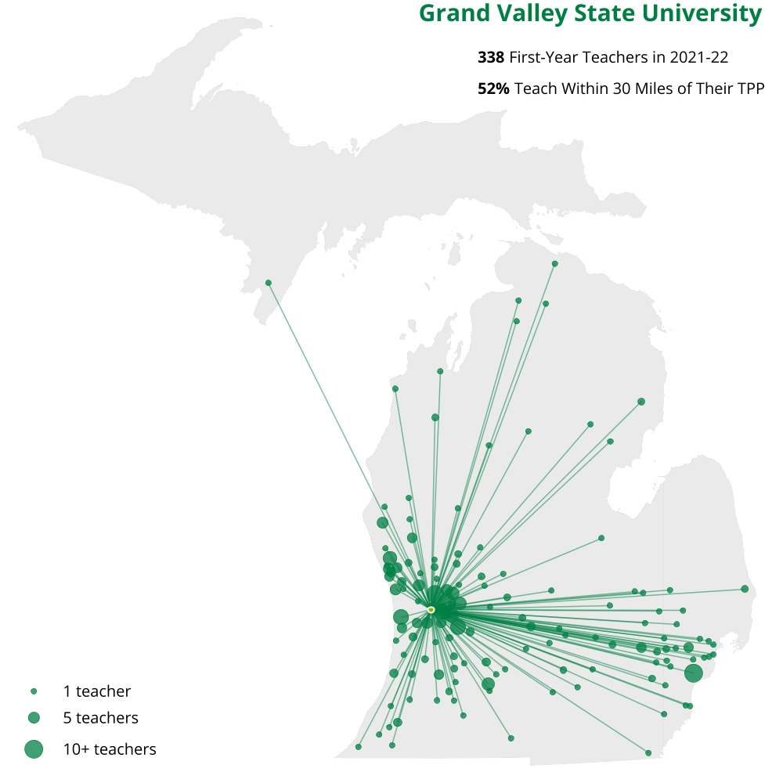
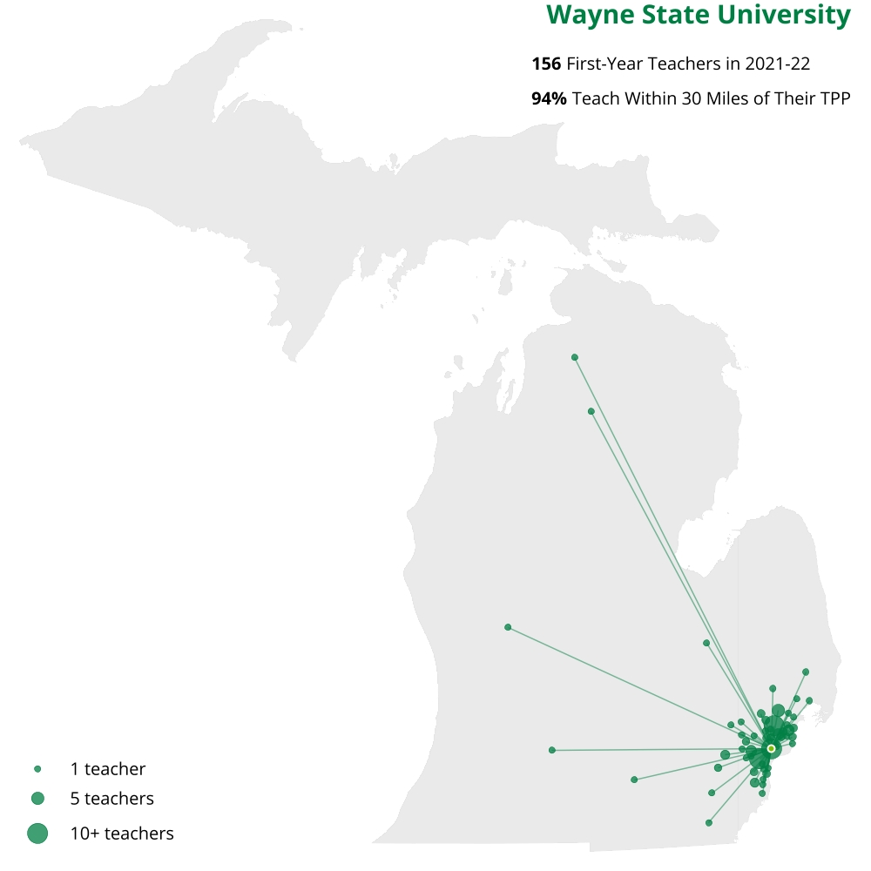
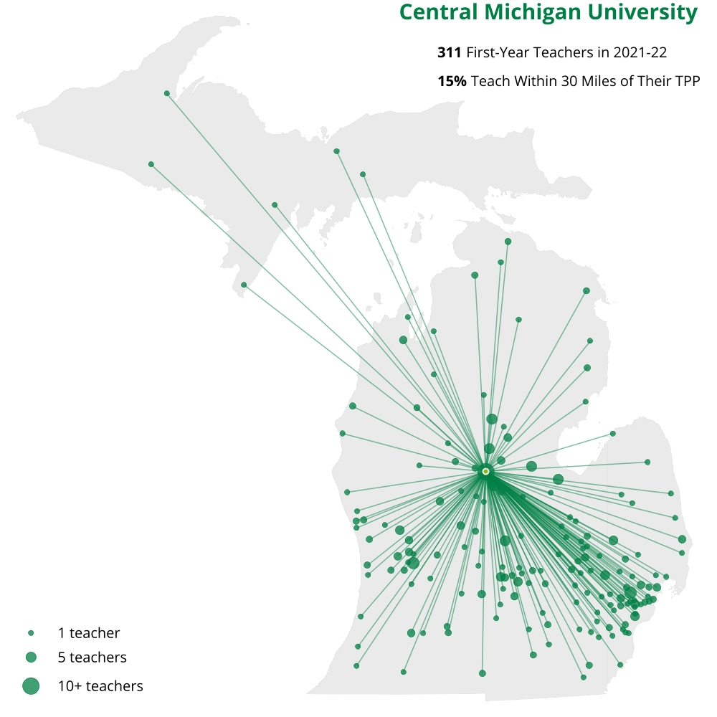
Teacher Preparation
Most MI teachers take their first jobs in districts close to their postsecondary institutions, although this varies widely by program and by region.
Grand Valley State University
52% Within 30 Miles
Wayne State University
94% Within 30 Miles
Central Michigan University
15% Within 30 Miles

Slide 20
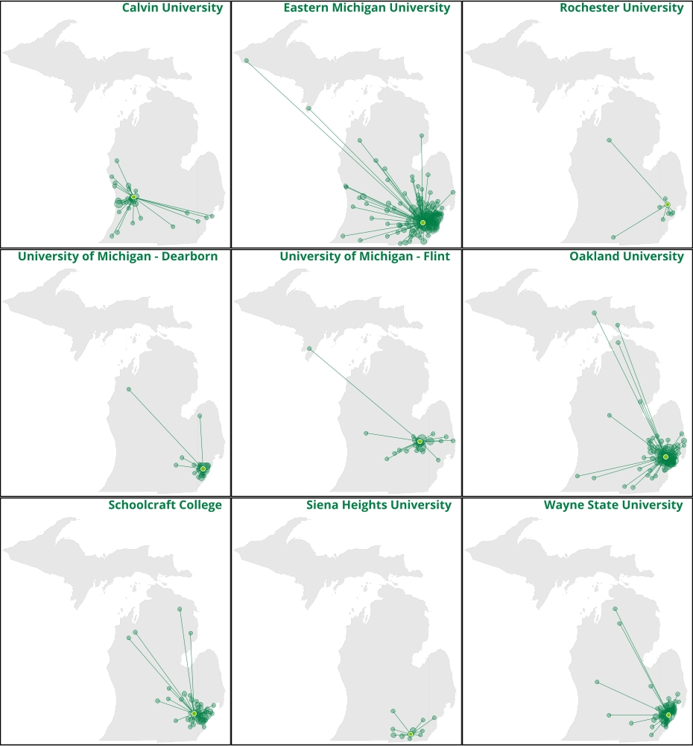
Teacher Preparation
Calvin University
Eastern Michigan University
Rochester University
71%
76%
80%
Graduates from these 9 teacher preparation providers are the most likely to stay within 30 miles for their first teaching jobs.
Univ. of Michigan - Dearborn
Univ. of Michigan - Flint
Oakland University
92%
82%
87%
8 out of 9 are located in the southeastern part of the state, 1 is in Grand Rapids.
Very few first-year teachers from these institutions worked in the upper peninsula or northern half of the lower peninsula.
Schoolcraft College
Siena Heights University
Wayne State University
81%
65%
94%

Slide 21
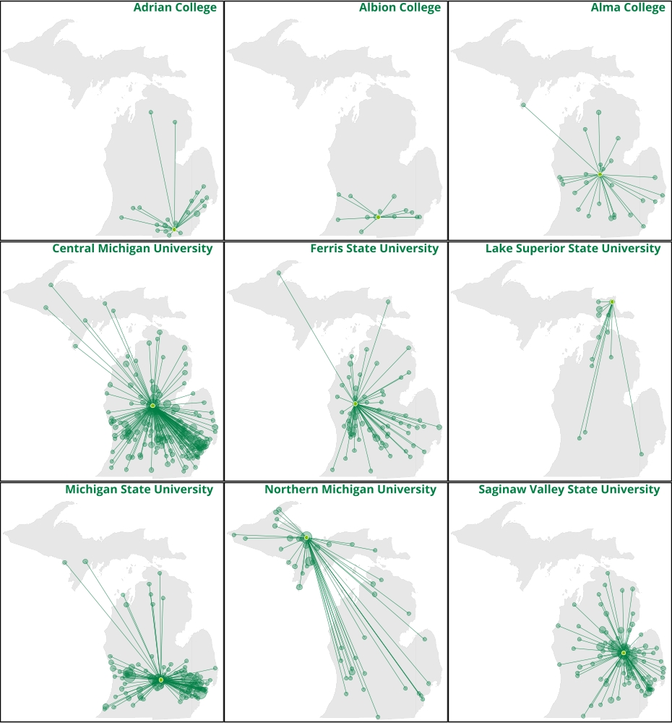
Teacher Preparation
Adrian College
Albion College
Alma College
32%
36%
18%
Graduates from these 9 teacher preparation providers are the least likely to stay within 30 miles for their first teaching jobs.
Central Michigan University
Ferris State University
Lake Superior State University
15%
19%
41%
Many of these providers are located in central MI and the upper peninsula.
Even though most graduates left the local area, they did not always reach all areas of the state.
Michigan State University
Northern Michigan University
Saginaw Valley State University
25%
23%
42%

Slide 22
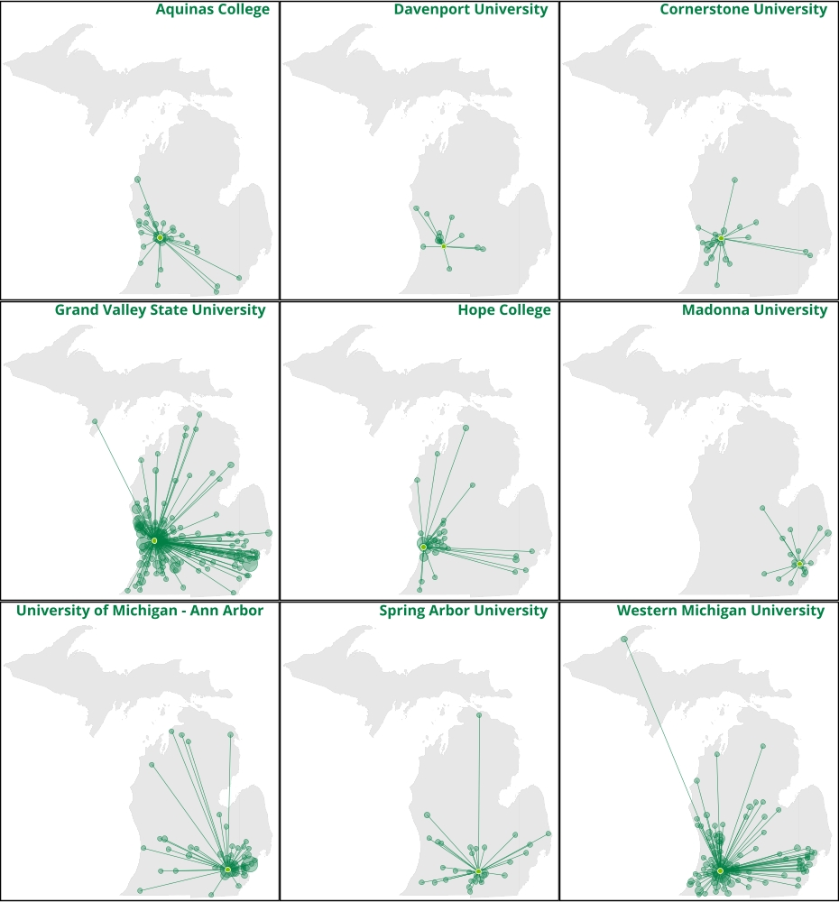
Teacher Preparation
Aquinas College
Davenport University
Cornerstone University
61%
59%
56%
Graduates from these 9 teacher preparation providers taught in both nearby and distant areas.
Grand Valley State University
Hope College
Madonna University
52%
61%
55%
All 9 are in the southern half of the lower peninsula. Several are in the Grand Rapids area.
Univ. of Michigan – Ann Arbor
Spring Arbor University
Western Michigan University
52%
43%
51%

Slide 23
Results: Highest-Need Regions

Slide 24
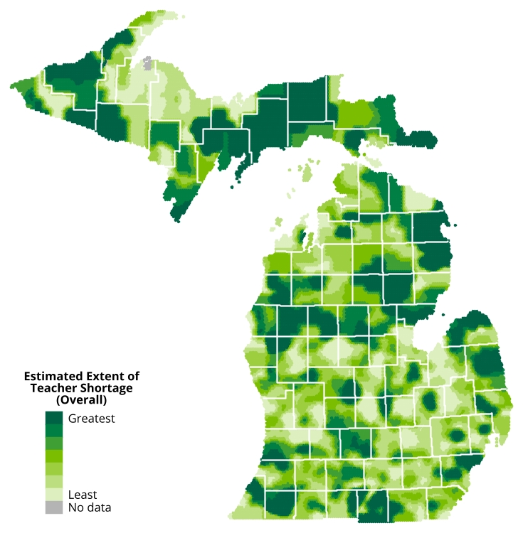
Highest-Need Regions
Teacher shortages in Michigan vary widely at the local level, even between close neighboring districts
Teachers Transferring to Other Schools or Districts (Fall-to-Fall)

Slide 25
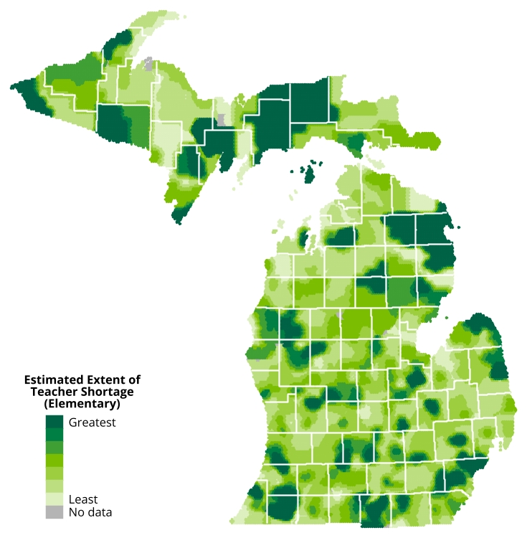
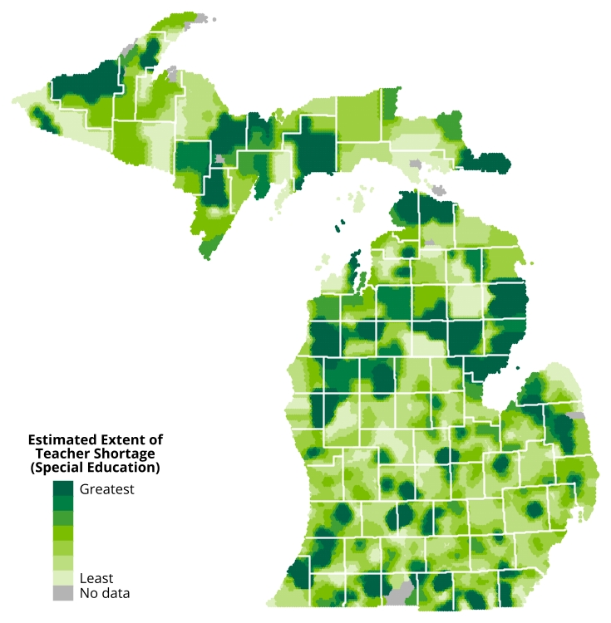
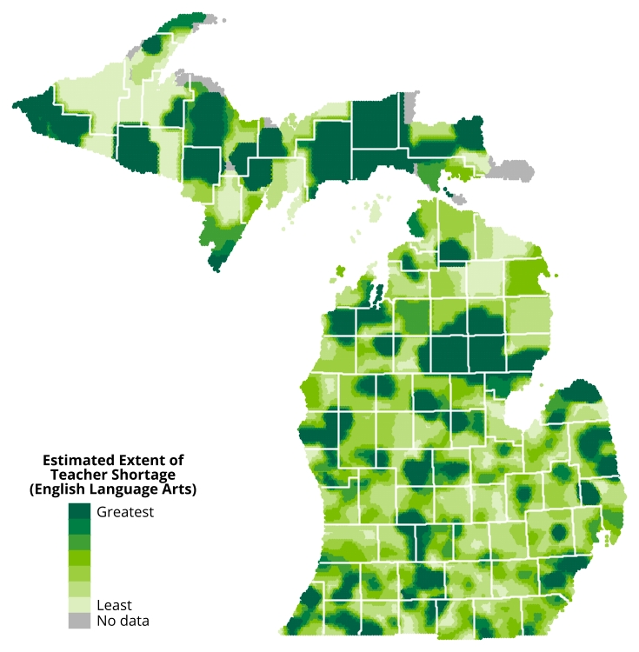
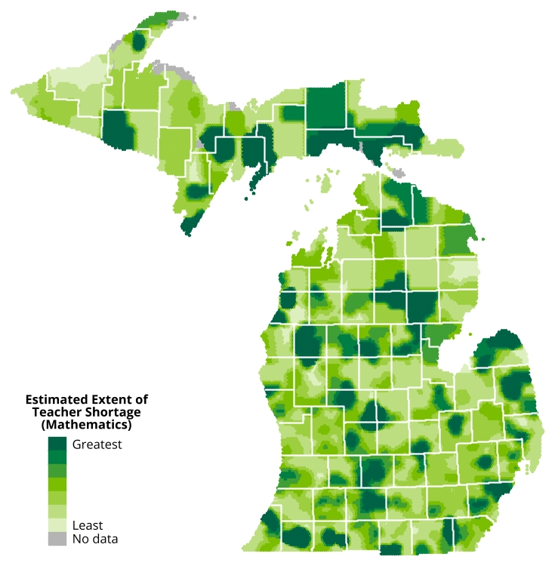
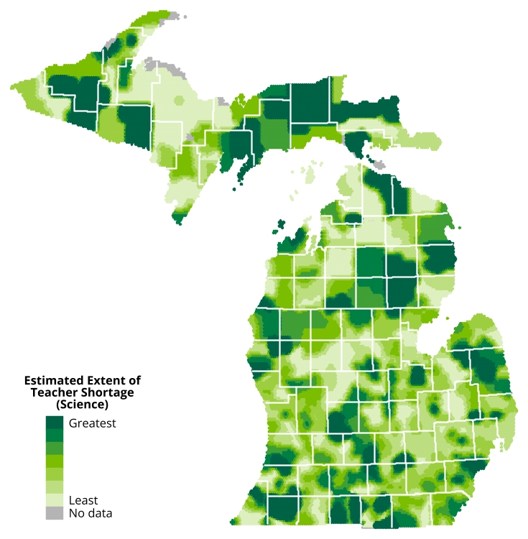
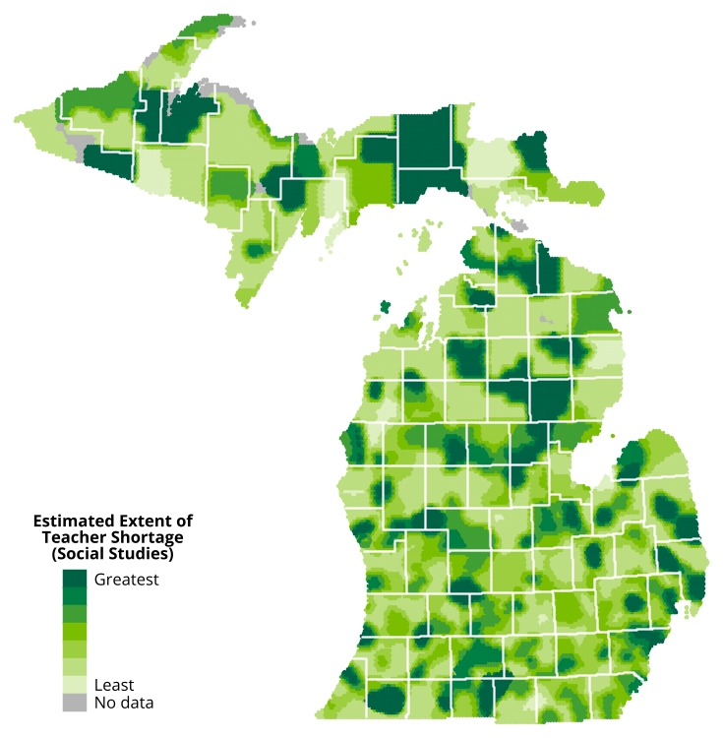
Highest-Need Regions
Some areas of the state are facing subject-specific shortages while others are facing shortages of all types of teachers.
Teachers Transferring to Other Schools or Districts (Fall-to-Fall)

Slide 26
Highest-Need Regions
Teacher preparation graduates are not choosing to teach in some of the highest-needs areas.
Locations of In-State TPP Graduates’ First Teaching Jobs
Teachers Transferring to Other Schools or Districts (Fall-to-Fall)

Slide 27
Implications
A one-size-fits-all solution to the teacher shortage may not be appropriate give variations in staffing challenges by region, locality, and teacher type.
Teachers Transferring to Other Schools or Districts (Fall-to-Fall)
Increasing the statewide supply of new teachers may not be enough to alleviate shortages in high-needs areas
MDE has engaged in several strategies and initiatives to support school districts in addressing the unique shortages in their own local communities.
These include Grown Your Own initiatives, registered apprenticeships, and programs that help middle and high school students explore/pursue careers as educators.

Slide 28
Tara Kilbride, Ph.D.
Assistant Director for Research, EPIC
kilbrid9@msu.edu
COLLEGE OF EDUCATION | MICHIGAN STATE UNIVERSITY
https://epicedpolicy.org | @EPICedpolicy

